Slide 1
Real Estate – Data Science Project
Can we predict the price of a certain real estate, given a certain amount of parameters?

Slide 2
How can we check if there are main characteristics that influence the market on real estate prices in Israel?
First step –
Data acquisition
Second step –
Data cleaning
Third step –
Exploratory data analysis
Fourth and last step –
Machine learning

Slide 3
Data acquisition

Slide 4
Data Acquisition Process
2 main sites were used in order to assemble all the data we needed:
yad2.co.il
Homeless.co.il
We used the Selenium and BeautifulSoup4 libraries in order to crawl to the websites and download the pages to our local stations. After that it was easy to address each page separately and create a data frame with all the data that we needed.

Slide 5
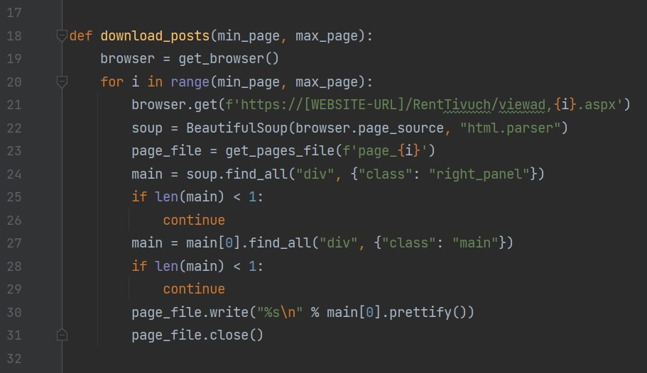
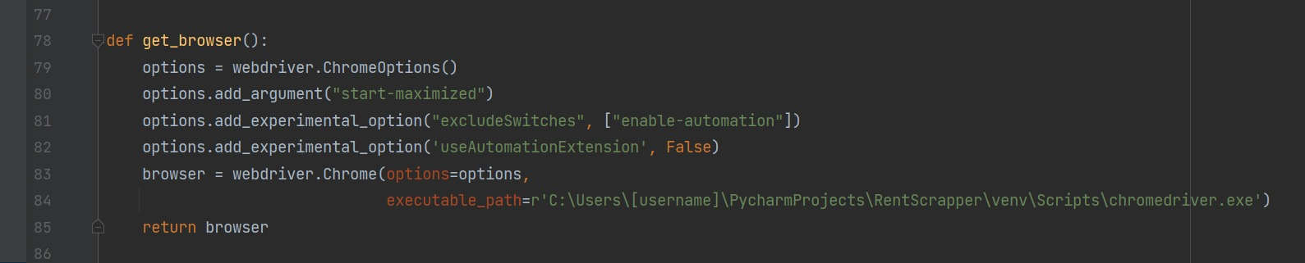
Crawling process

Slide 6
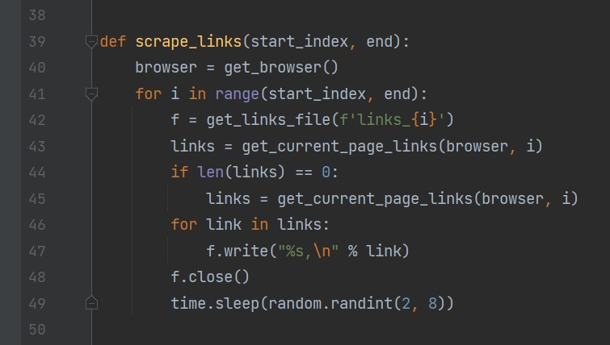
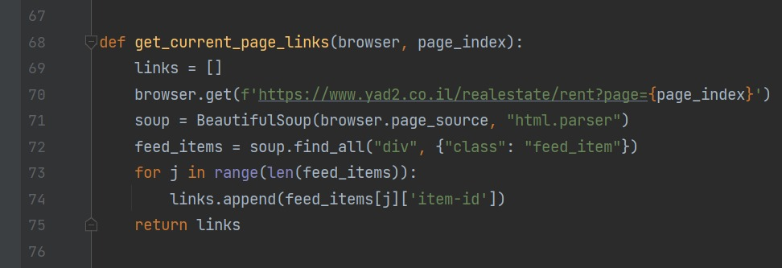

Slide 7
Data cleaning

Slide 8
Data cleaning process
Removing duplicates.
Removing ads without price.
Removing corrupted ads.
Converting foreign currency.
Merging data from both sources.

Slide 9
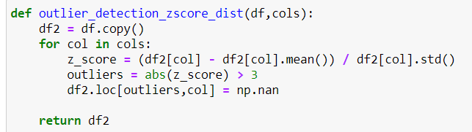
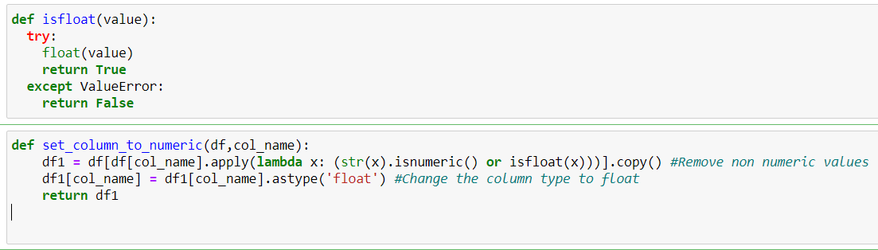

Slide 10
Raw data:
70,000 rows
After data cleaning process:
48,391 rows

Slide 11
EDA- Exploratory data analysis

Slide 12
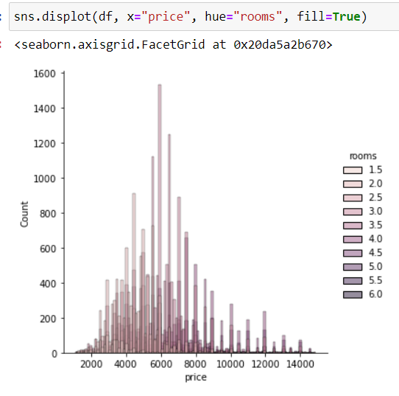

Slide 13
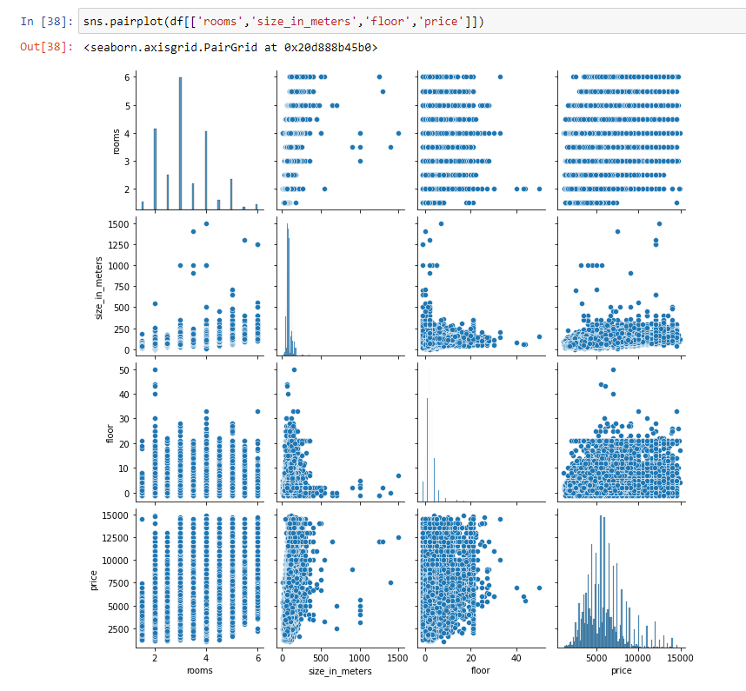

Slide 14
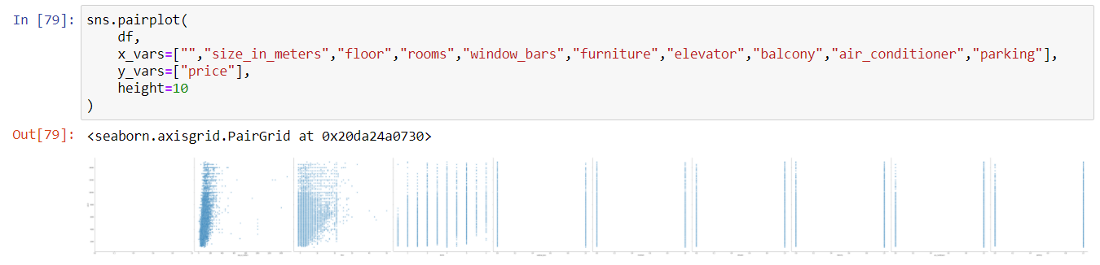

Slide 15
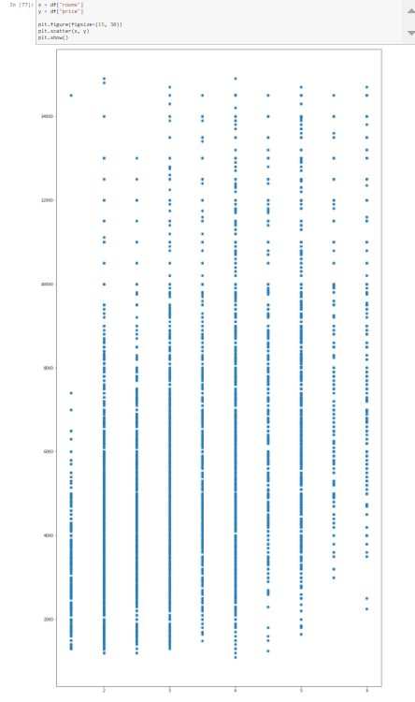

Slide 16
Machine Learning

Slide 17
Machine learning process
We tried to use 2 different regression techniques that were taught in class, Linear and Logistic. Logistic regression was not the most suitable one here, so we chose to stay with results from the linear regression.

Slide 18
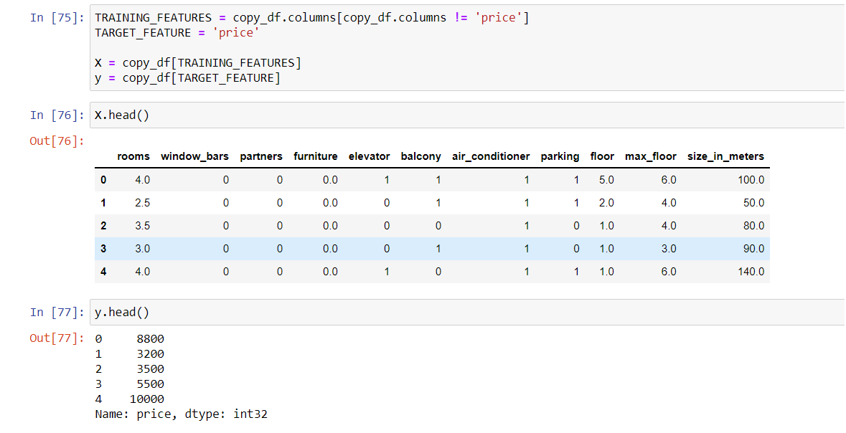
First approach

Slide 19
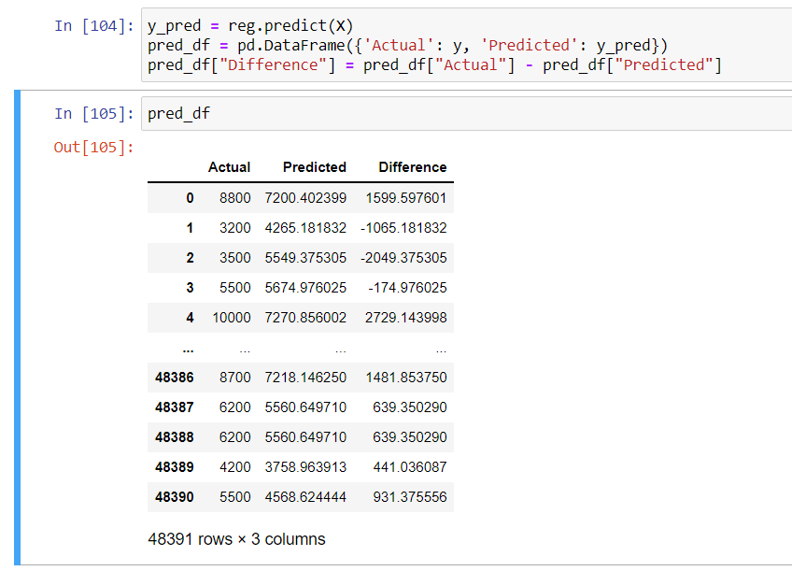

Slide 20
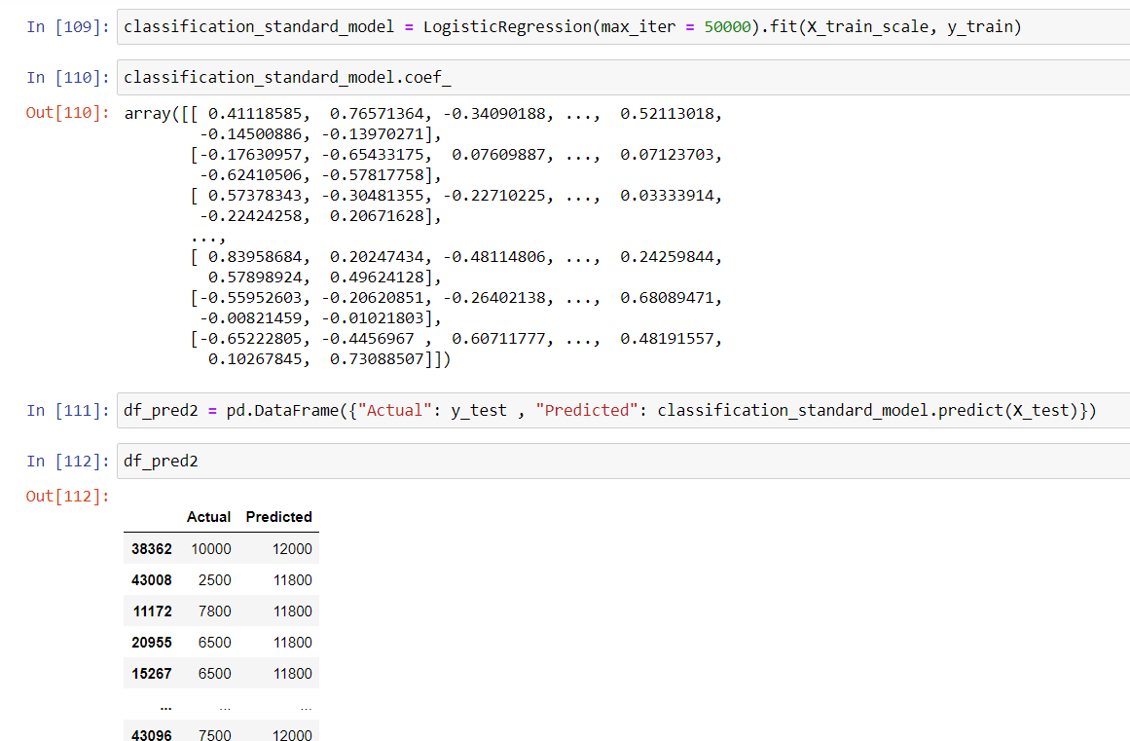
Second approach

Slide 21
Conclusion

Slide 22
We can approximately guess the price of the real estate if a certain amount of parameters are given.
In order to guess the correct price, more parameters are needed.
Thank you for staying with us up until this part (yes yes, we know you had to, but nevertheless) ☺

